Slide 1

MARS Real Estate Investment Inc.
…we serve the future
Instructor “CEO”: Yacov Salomon Investment Strategy Project Team: Paco Aguirre
Kevin Drever Jesse Keller Vasudev Killada
Joseph Wood

Slide 2
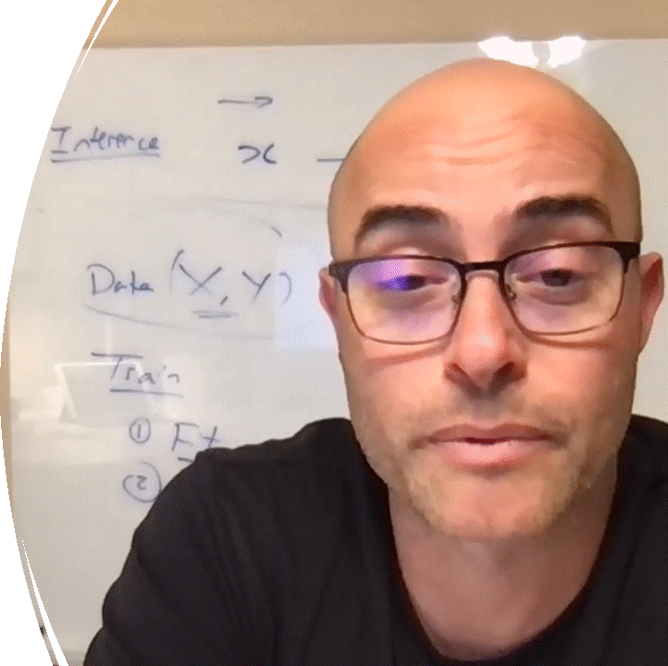
…IT ALL STARTED ON
…May 3, 2021
…the much awaited
CEO vision statement
…Infinte Insights from Inference!
Inference problem Given an X predict y

Slide 3
PROBLEM STATEMENT
Data Source https://www.kaggle.com/c/house-prices-advanced-regression-techniques (train.csv)
Explanatory (X) 79 43 categorical, 38 numerical
Dependent(y) SalePrice
Train - 1,460 residential property sales observations with 80-20 split train/dev.
Test - 1,459 observations
Metrics
Root mean squared error (RMSE)
R Squared (R2)
Standard Deviation (SD)
INFERENCE PROBLEM:
Given a set of features about a home, predict the sale price using advanced machine learning algorithm. Our objective is also to have a high prediction accuracy compared to our baseline using OLS Regression

Slide 4
STRATEGY
01
02
03
PRELIMINARY DATA AND EDA
FEATURE ENGINERING/SELECTION
BASELINE SCORE
04
05
06
HYPER PARAMETER TUNING
ERROR ANALYSIS/ENSEMBLE
ADVANCED MODELING/NEXT STEPS
Visualize data and distribution
Data sanity
Feature analysis
Linear Regression
Visualize data and distribution
Data sanity
Feature analysis
Manual
GridSearch
Randomized Search
Mean of Predictions(couldn’t implement, only proposed in our meetings)
Neural Network
Gradient

Slide 5
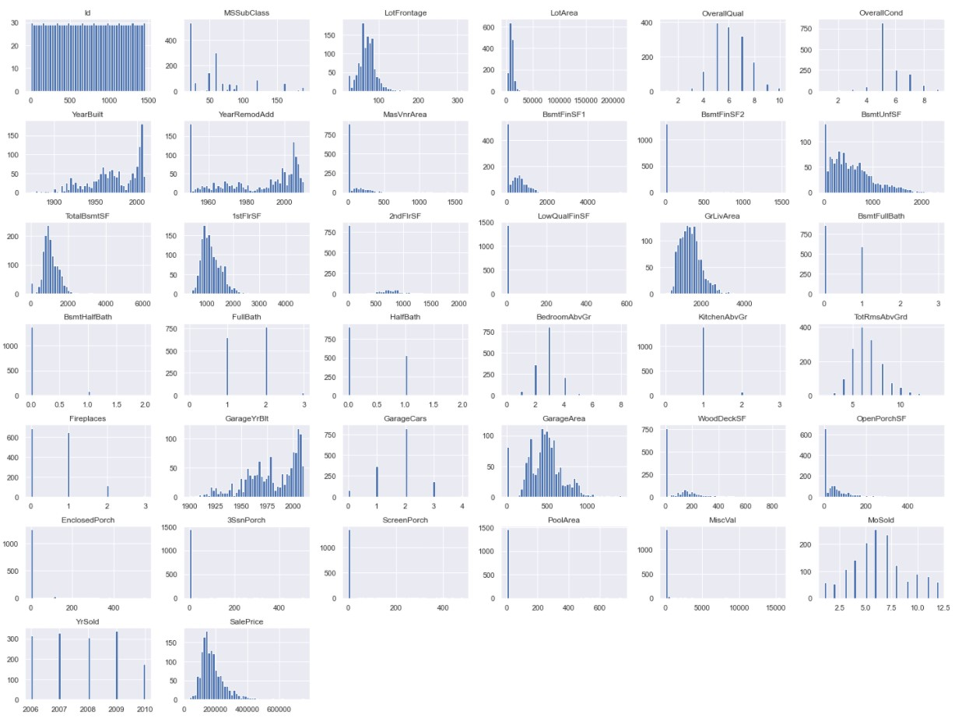
DATA EXPLORATION
Relatively complicated dataset with 1480 rows and 79 features (in the training dataset).
Used matrix scatter plots to explore any easy correlations between features and price.
Notable features:
Frontage
Square Footage
Year Built

Slide 6
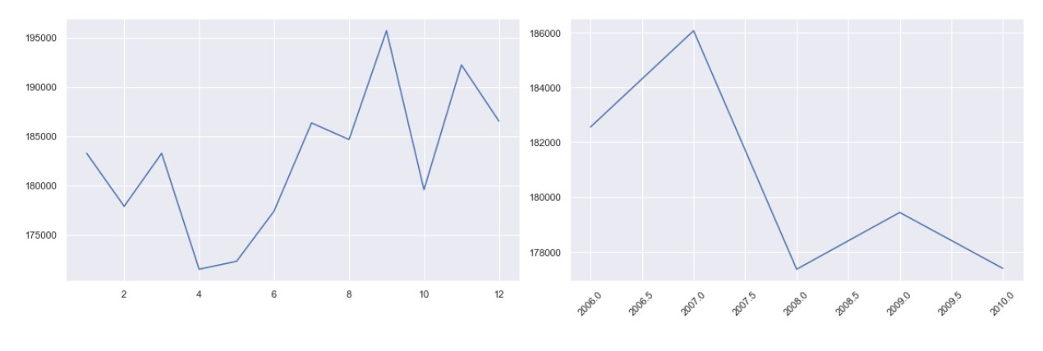
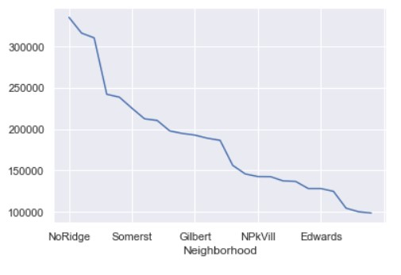
DATA EXPLORATION
Again, using simple charts, explored a few more complex relationships like month, year and neighborhood for further feature extraction.
Avg Sales Price
X
Y
Month of Year
Year
For example, the month of the sale didn’t matter, but there was a possible year-over-year trend. Neighborhood seemed to be a possible predictor as well.
Avg Sales Price
Y

Slide 7
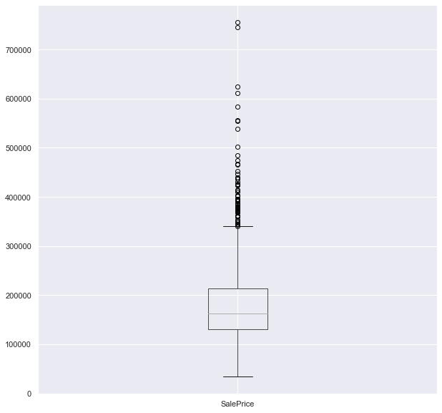
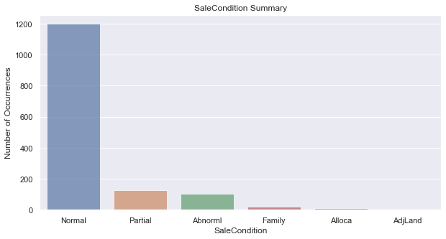
DATA EXPLORATION
Next looked for data that may have long tails or small numbers of examples for a category. We were searching for elements that may need some transformation before training.
Outliers
Median=$150k
Categories with few examples

Slide 8

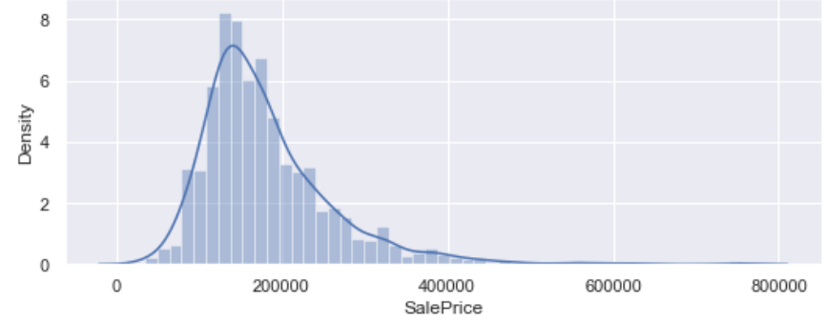
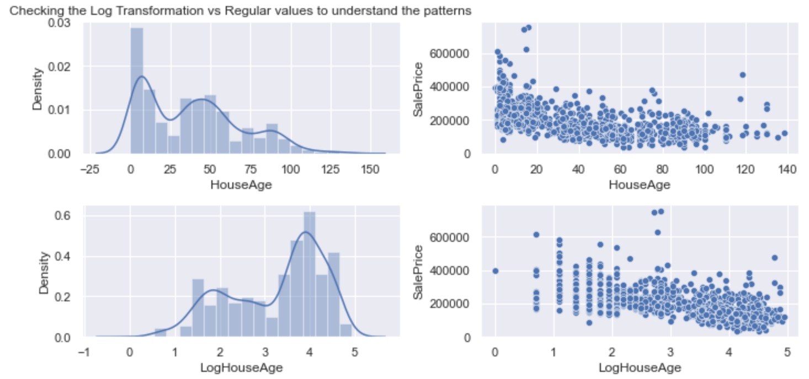
FEATURE ENGINEERING
HouseAge – New homes are more valuable
SalePrice – Tall towers and fat right tails
Log Transformation implemented
Log Transformation implemented

Slide 9
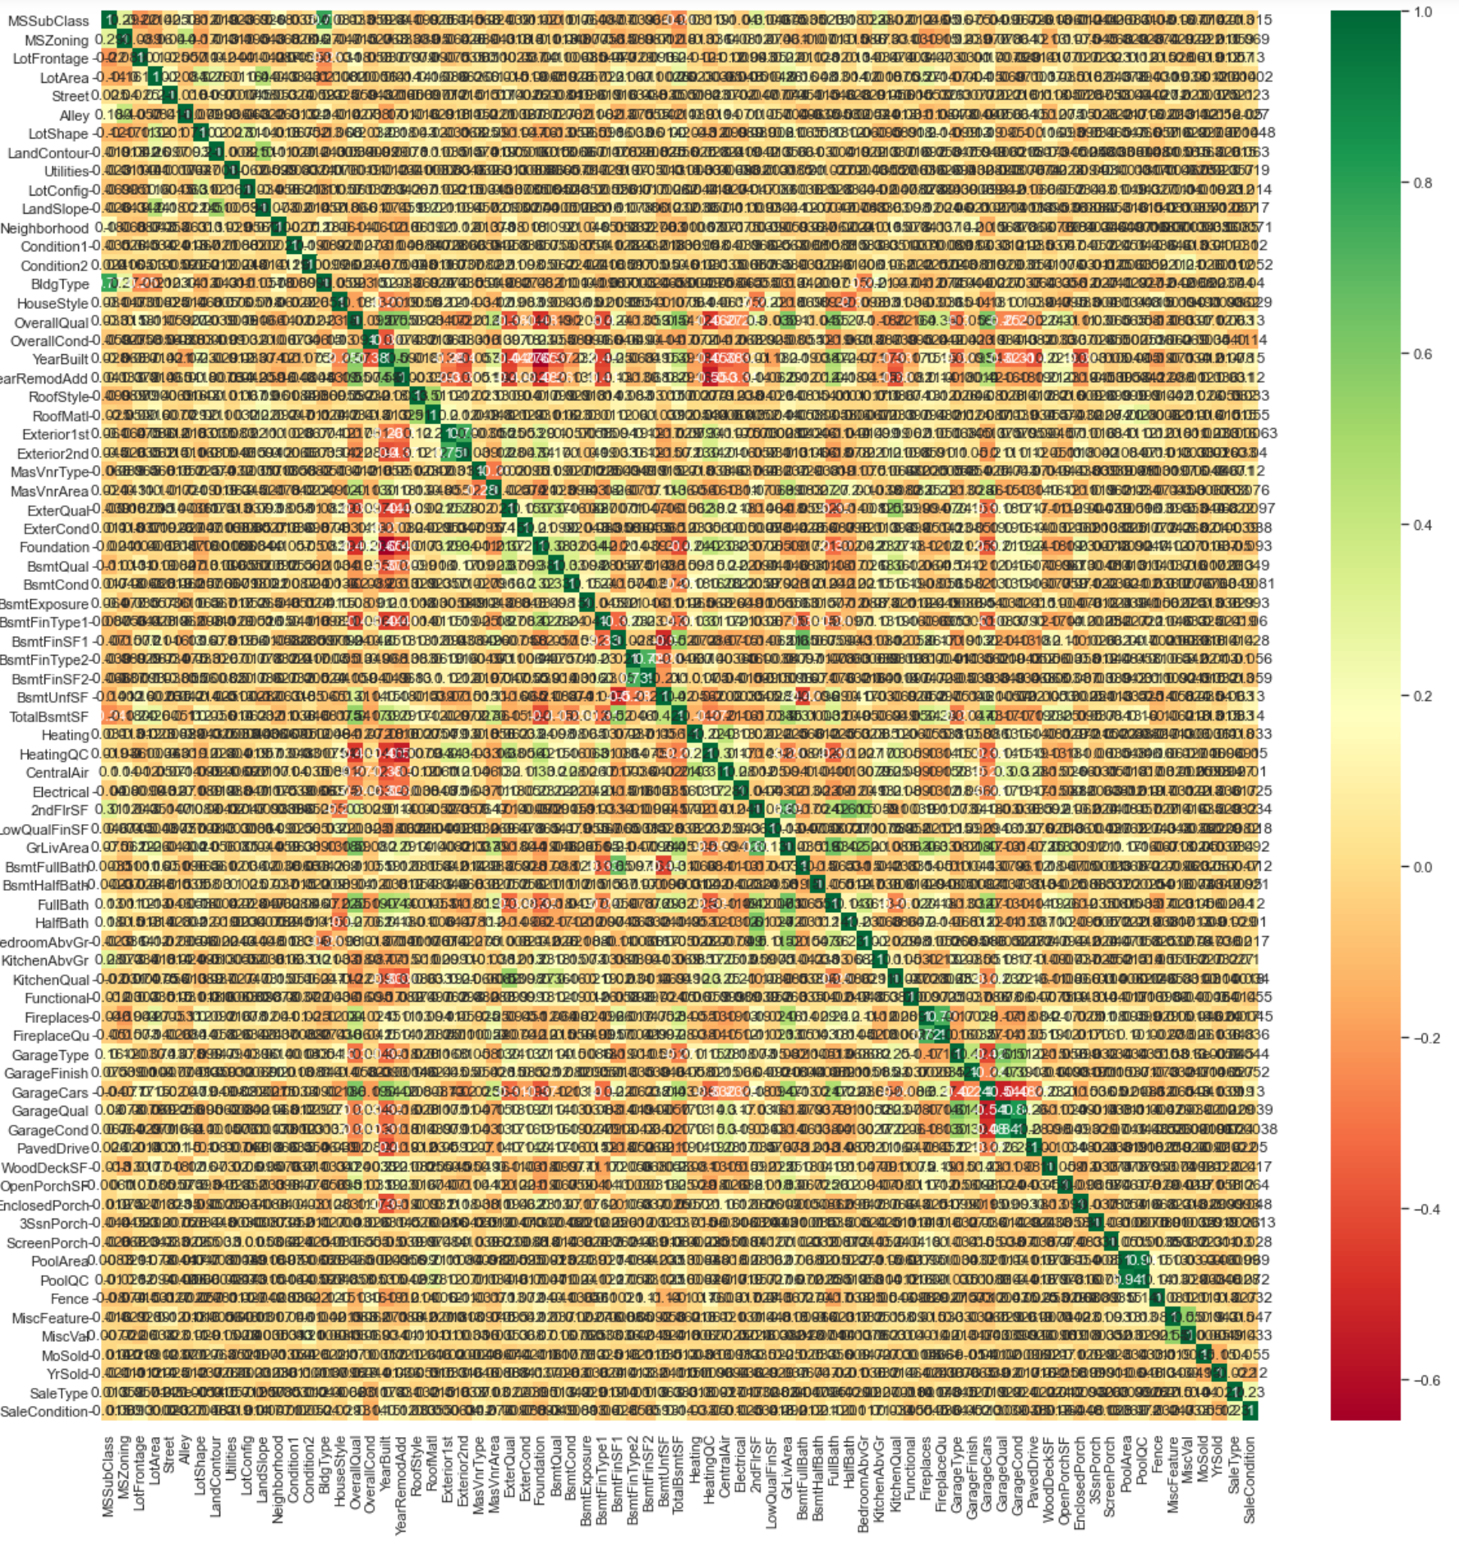
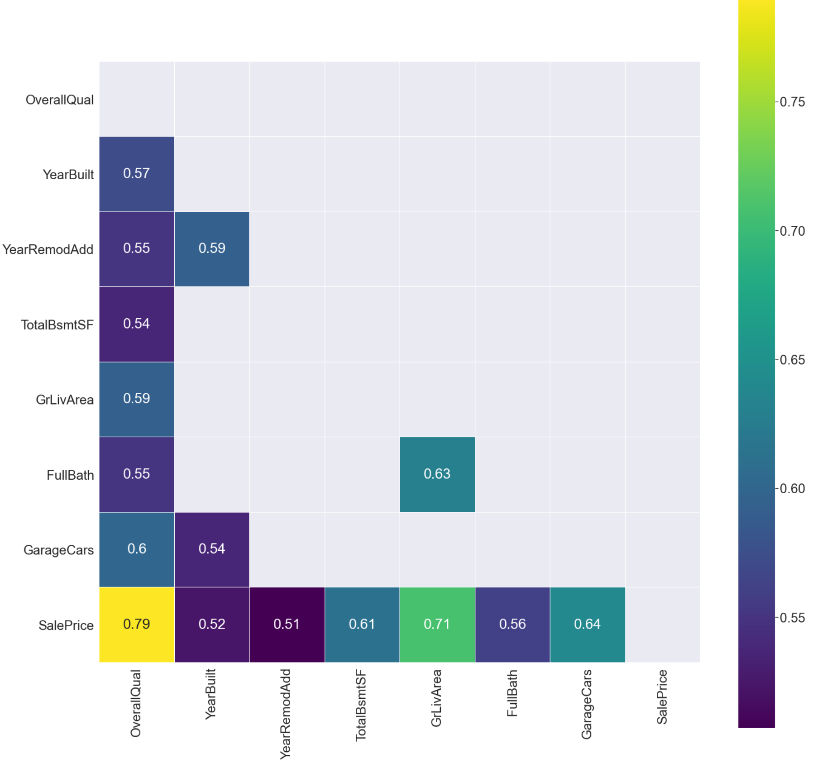
FEATURE SELECTION EVOLUTION
CORELATION > 0.5

Slide 10
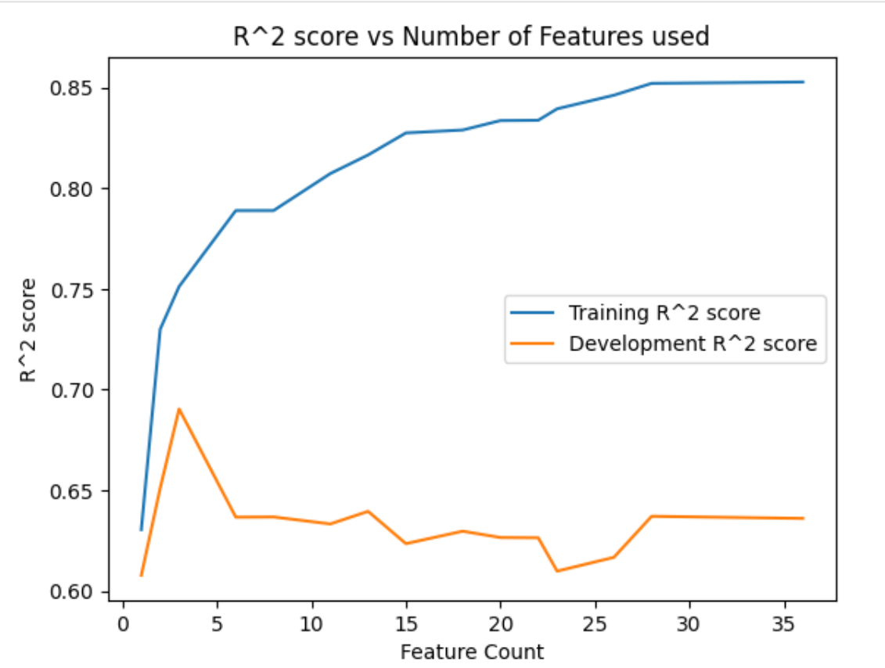
FEATURE SELECTION EVOLUTION
Sale Price Correlation
Feature | Correlation |  | Feature | Correlation
SalePrice | 1.000000 |  | BsmtFullBath | 0.227122
OverallQual | 0.790982 |  | BsmtUnfSF | 0.214479
GrLivArea | 0.708624 |  | BedroomAbvGr | 0.168213
GarageCars | 0.640409 |  | ScreenPorch | 0.111447
GarageArea | 0.623431 |  | PoolArea | 0.092404
TotalBsmtSF | 0.613581 |  | MoSold | 0.046432
1stFlrSF | 0.605852 |  | 3SsnPorch | 0.044584
FullBath | 0.560664 |  | BsmtFinSF2 | -0.011378
TotRmsAbvGrd | 0.533723 |  | BsmtHalfBath | -0.016844
YearBuilt | 0.522897 |  | MiscVal | -0.02119
YearRemodAdd | 0.507101 |  | Id | -0.021917
GarageYrBlt | 0.486362 |  | LowQualFinSF | -0.025606
MasVnrArea | 0.477493 |  | YrSold | -0.028923
Fireplaces | 0.466929 |  | OverallCond | -0.077856
BsmtFinSF1 | 0.38642 |  | MSSubClass | -0.084284
LotFrontage | 0.351799 |  | EnclosedPorch | -0.128578
WoodDeckSF | 0.324413 |  | KitchenAbvGr | -0.135907
2ndFlrSF | 0.319334 |  | MSSubClass | -0.084284
OpenPorchSF | 0.315856 |  | EnclosedPorch | -0.128578
HalfBath | 0.284108 |  | KitchenAbvGr | -0.135907
LotArea | 0.263843

Slide 11
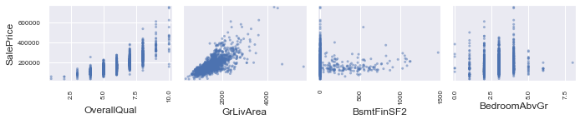
FEATURE SELECTION EVOLUTION
Looking at scatter matrix:
Feature | Correlation
OverallQual | 0.790982
GrLivArea | 0.708624
BedroomAbvGr | 0.168213
BsmtFinSF2 | -0.011378
Then we:
Changed ordinal categories to numbers by using a scale mapper
Deploy a trained imputer to transform the missing numerical to median.
Use one hot encoding for nominal categories.

Slide 12
BASELINE MODEL SCORING – Using RMSE
Probably:
RF is immune to outliers.
Unlike other algorithms, RF ignores any statistical issues
RF handles missing values
More trees won’t overfit
Information Gain/Entropy and GIGI index approach outweighs other models?
LINEAR REGRESSION
RMSE– $21,218
DECISION TREE
RMSE– $43,984
RANDOM FOREST
RMSE– $33,988
SVM
RMSE– $34,602

Slide 13
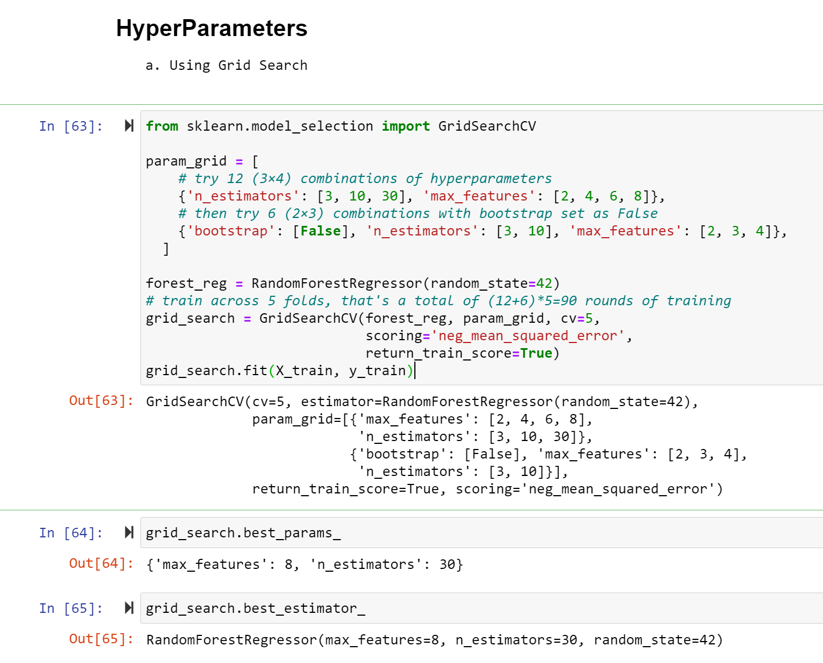
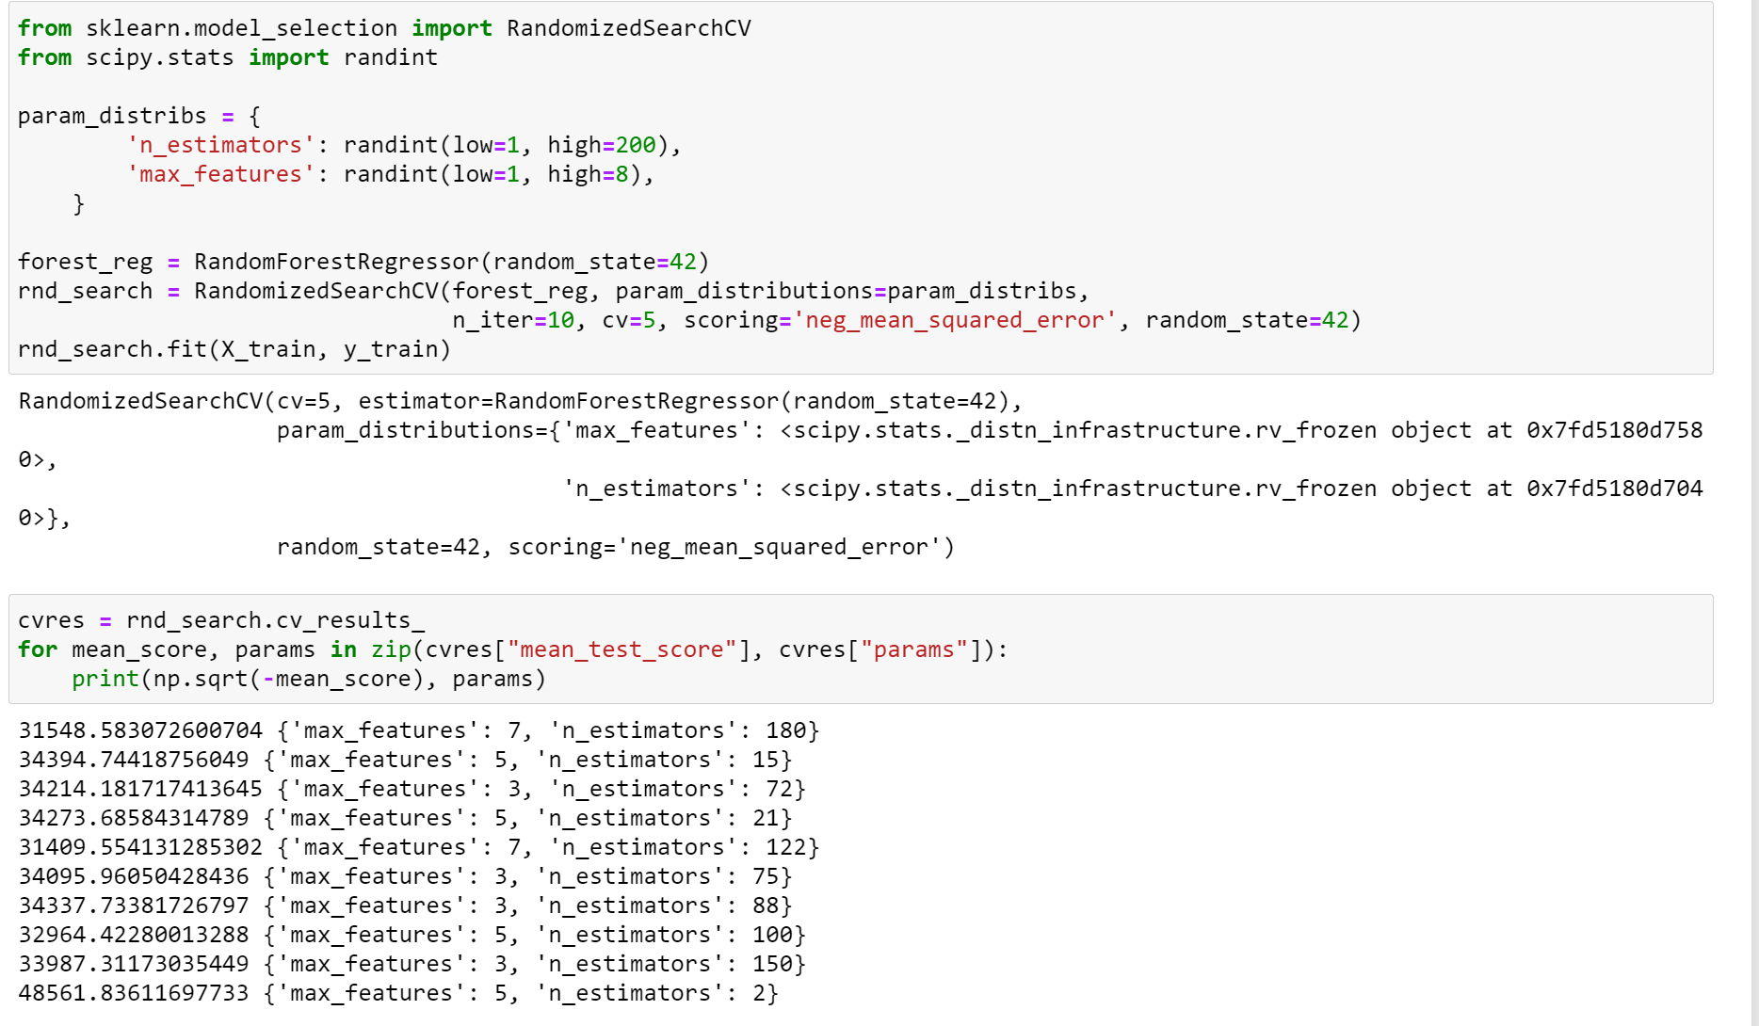
HYPER PARAMETER TUNING

Slide 14
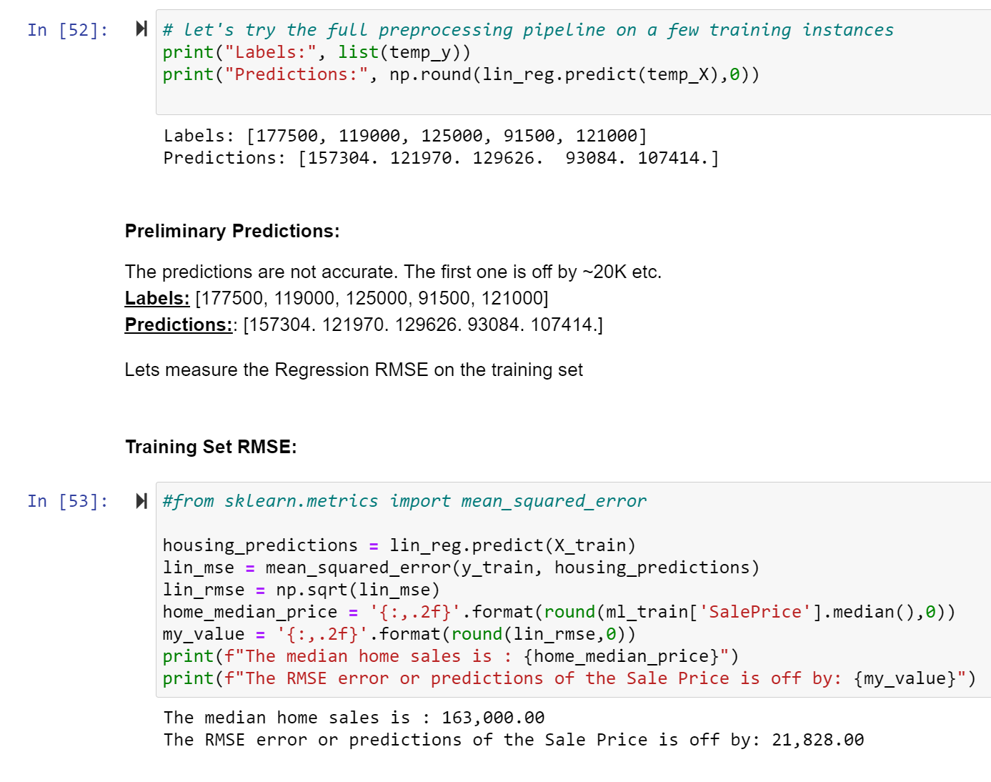
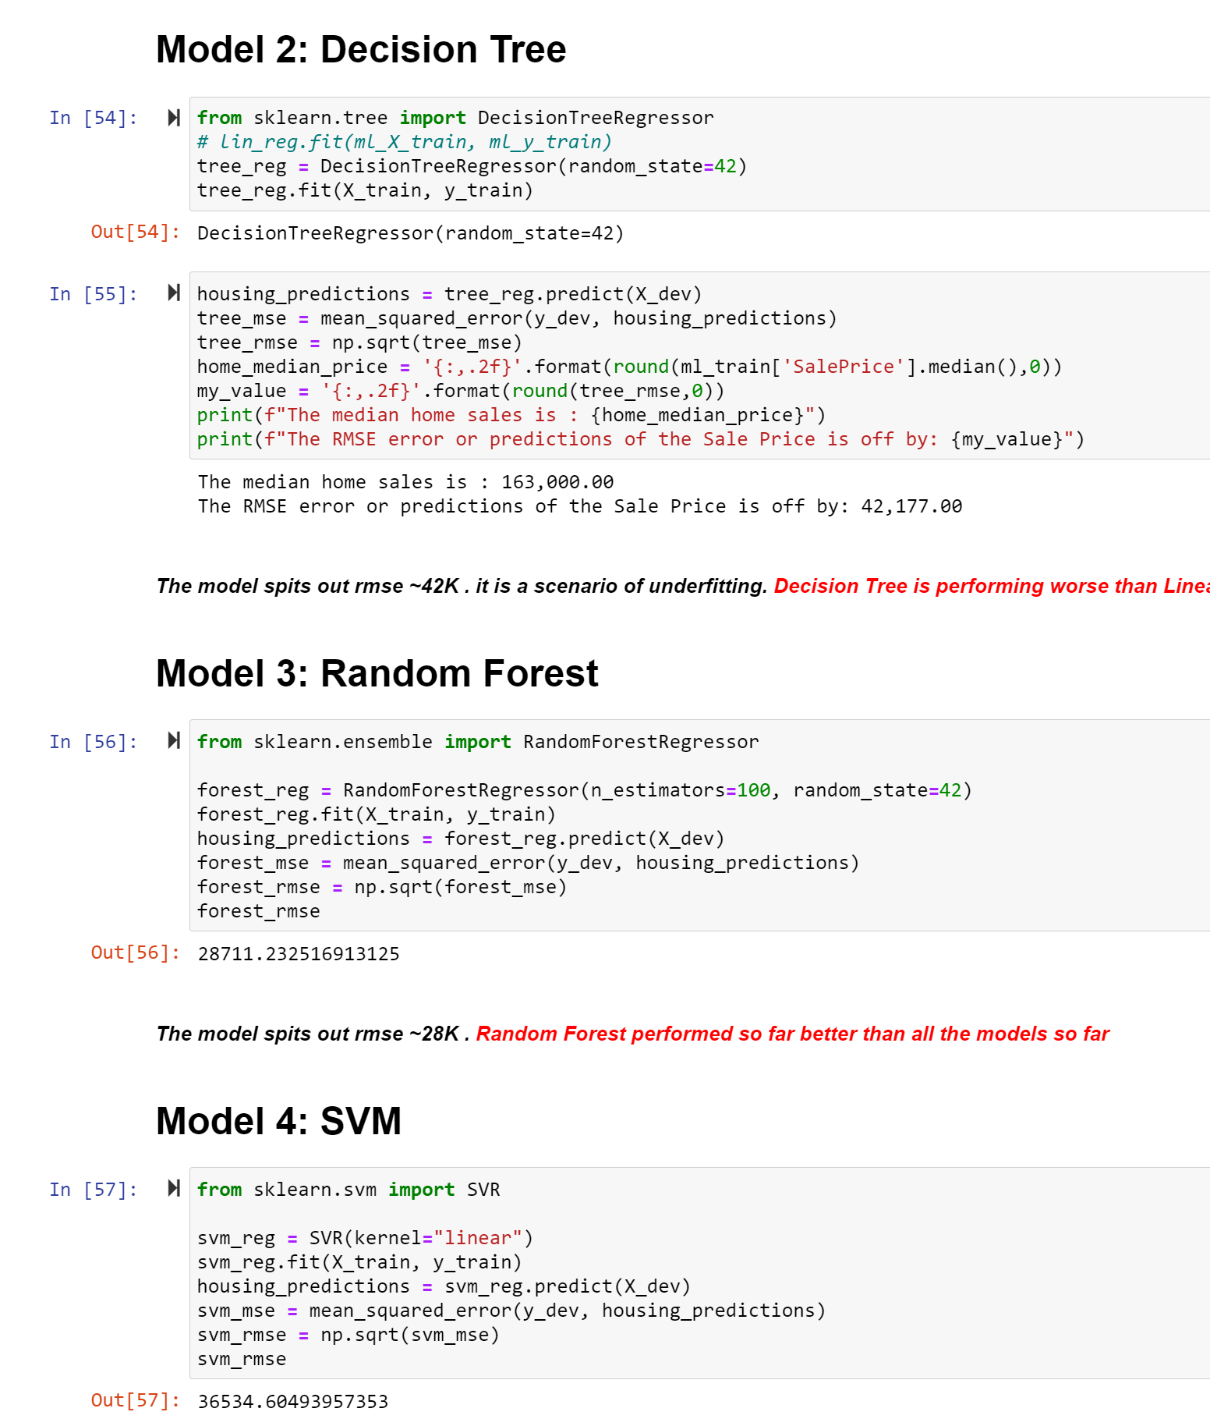
MODEL SCORES

Slide 15
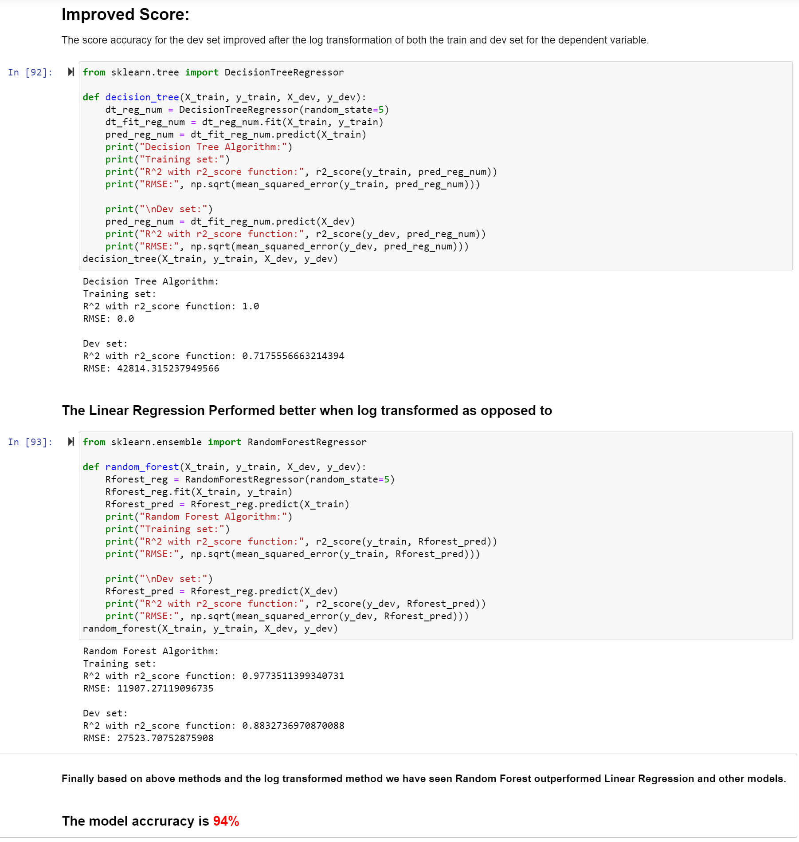
MODEL SCORES

Slide 16
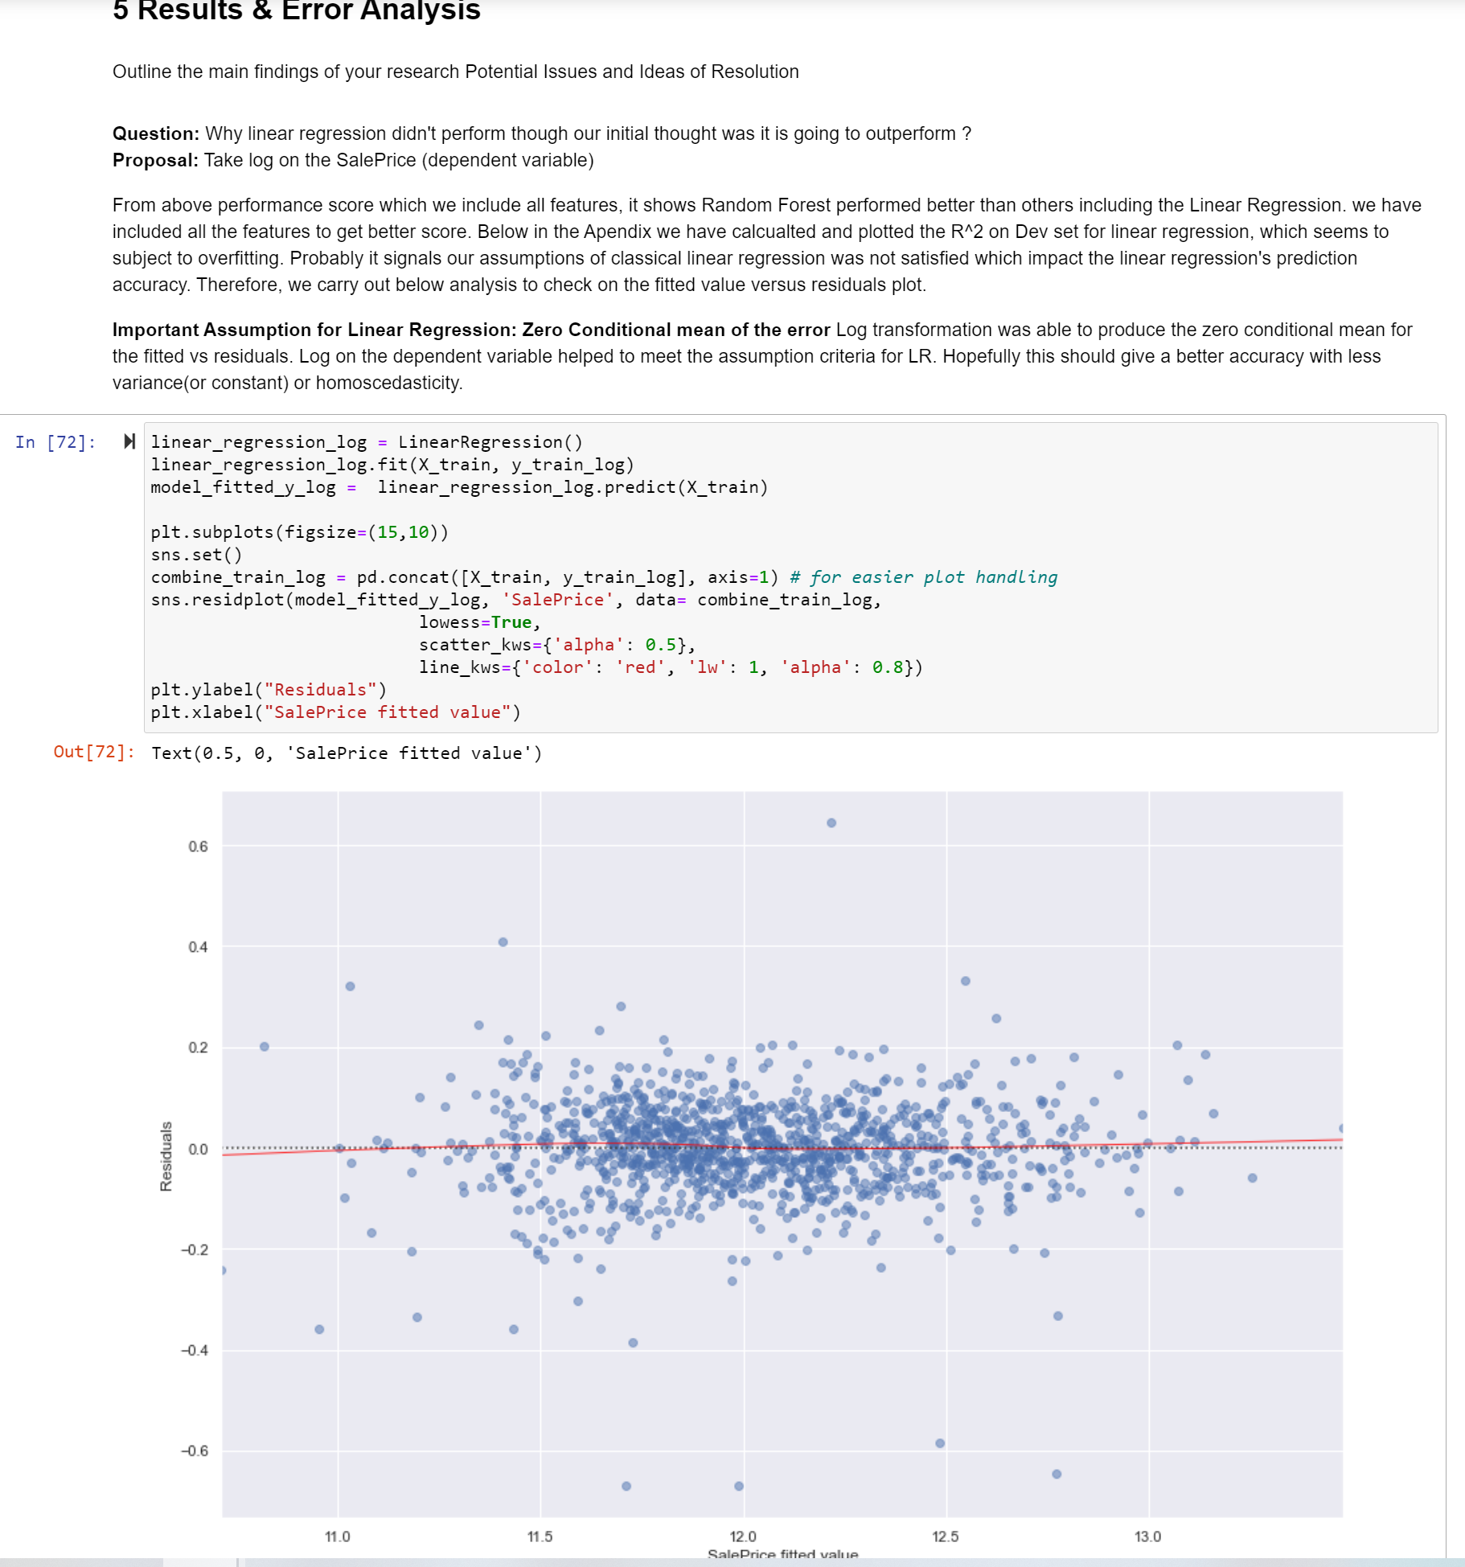
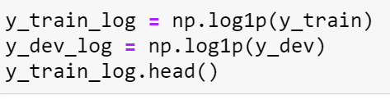
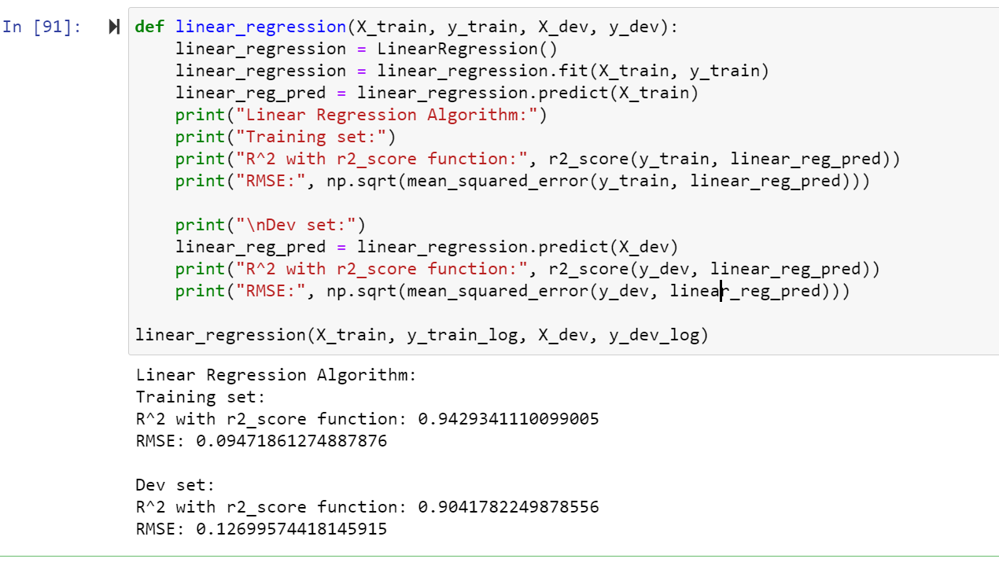
MODEL SCORES
1
2
Log transformed
Model Accuracy

Slide 17
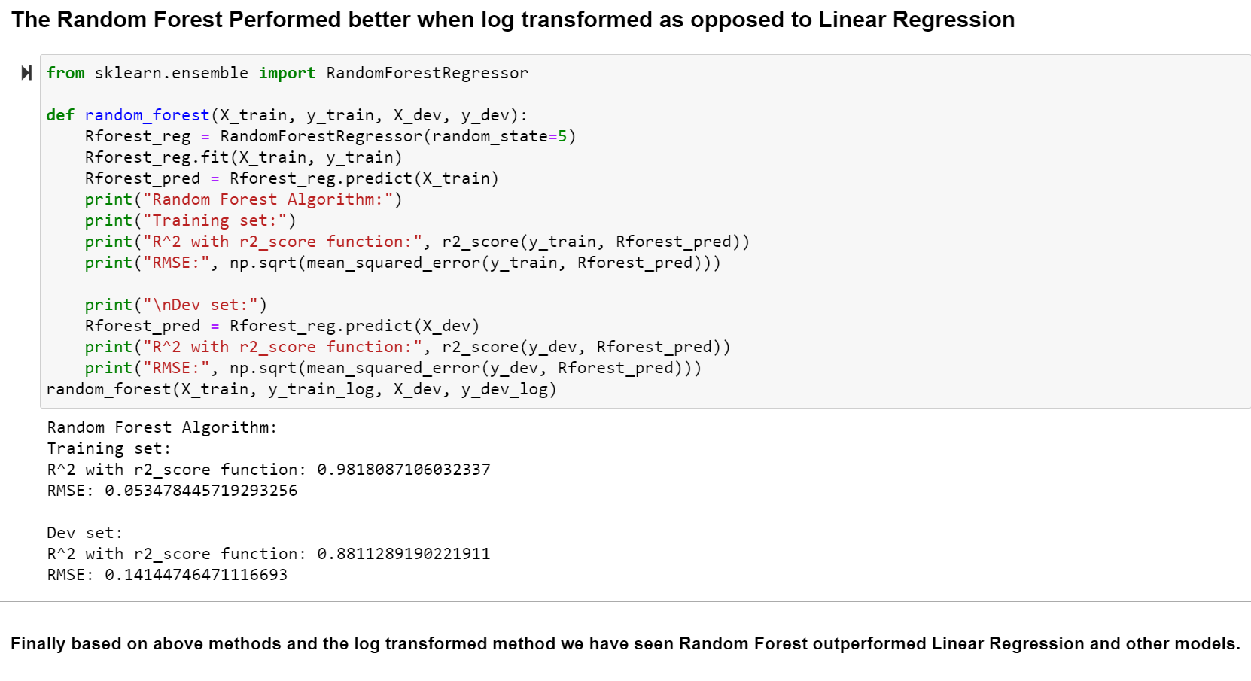
MODEL SCORES
2
1st Runner
Winner

Slide 18
NEXT STEPS
ENSEMBLE
Neural Network
Gradient
THOROUGH FEATURE SELECTION
PROCURE MORE DATA
PIPELINE IMPLEMENTATION

Slide 19
READY TO INVEST IN OUR COMPANY
OR
QUESTIONS ???

